Slide 1

LIBRARY DATABSE MANAGEMENT

Slide 2
About me
I am a B.tech Graduate in Electrical and Electronic Engineering from VNRVJIET
I worked as Process Associate in GENPACT pvt.ltd for 1.8 years
As a Process Associate I had worked on different software's like tablue, and excel. From there I got a strong interest in data science. Therefore with passion and interest I started to learn deep into Data Science.
LinkedIn:- http://www.linkedin.com/in/sameer-mohammad-04jan1999
GitHub:- https://github.com/SameerMohammad1902

Slide 3
Objective of the Project
Analyze and extract meaningful data from a library management system to evaluate book inventory distribution, borrower activity, and branch performance.
By identifying key relationships between database tables and uncovering usage patterns, the goal was to generate actionable insights that optimize resource allocation, improve borrower management, and enhance overall library operations.
We aimed to support data-driven decision-making by providing detailed, branch-specific statistics and identifying areas for operational improvement.

Slide 4
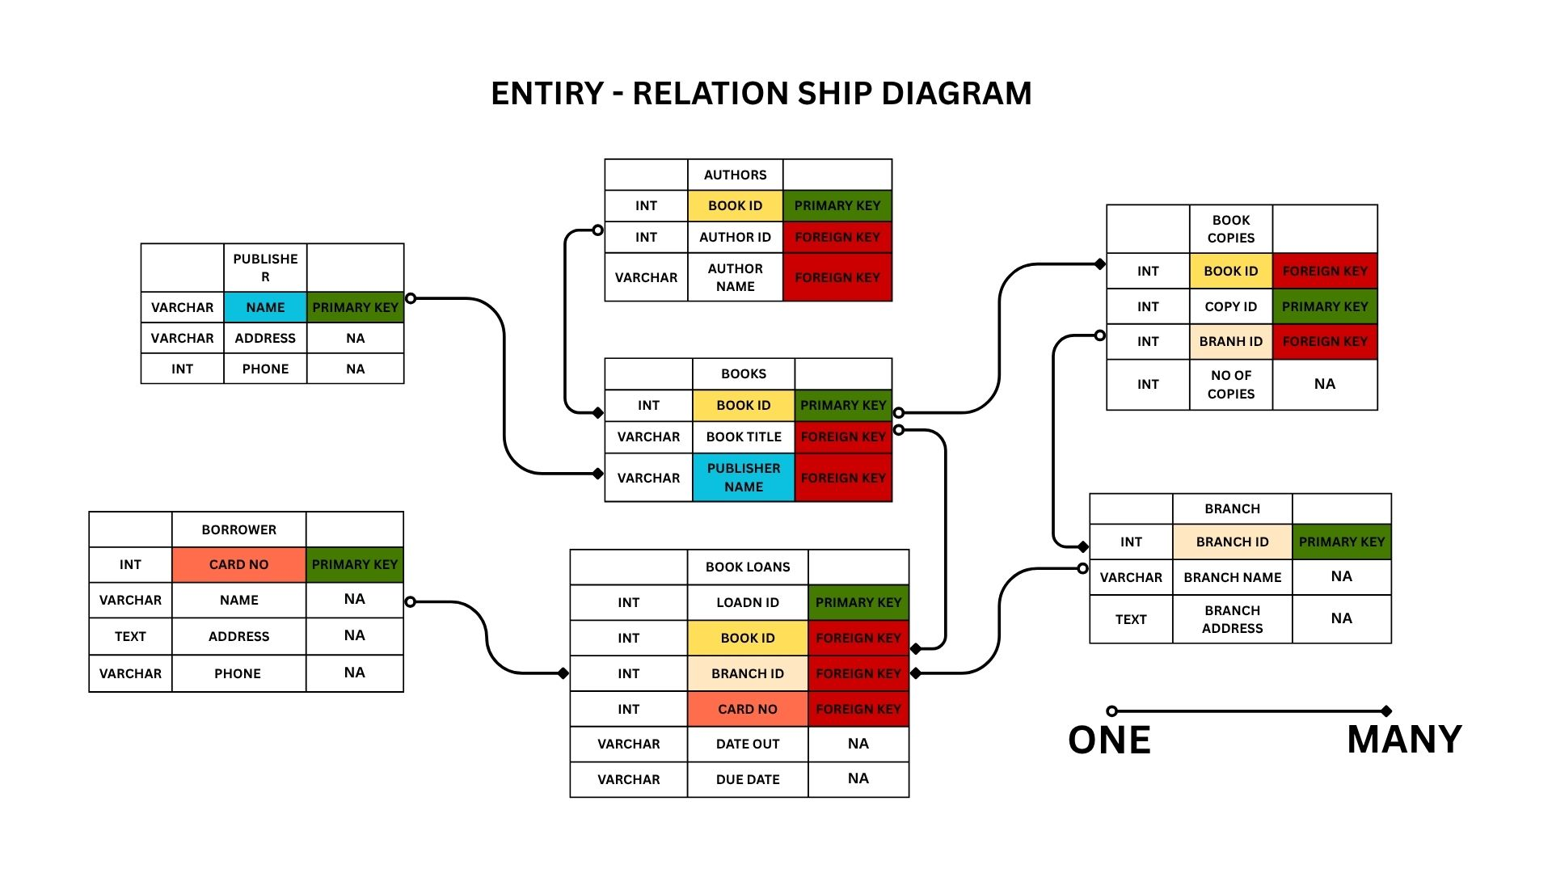
ENITITY AND SCHEMA

Slide 5
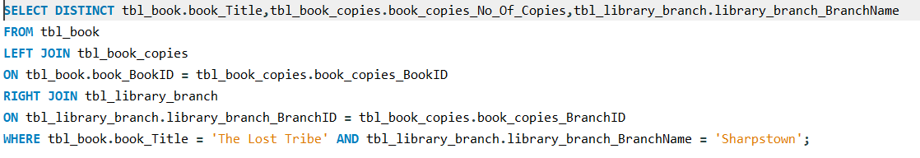
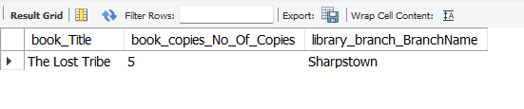
How many copies of the book titled "The Lost Tribe" are owned by the library branch whose name is "Sharpstown"?
Code:
Output:
A total number of 5 copies of “ The Lost Tribe “ are owned by the Sharpstown branch.

Slide 6
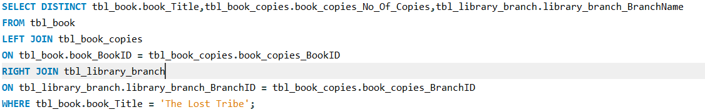
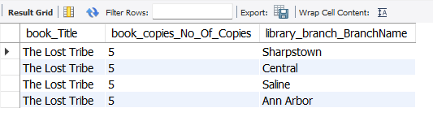
How many copies of the book titled "The Lost Tribe" are owned by each library branch?
Code:
Output:
A Total copies of 5 book titled “The Lost Tribe” are owned by each the 4 library's.

Slide 7
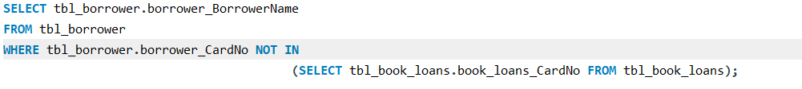

Retrieve the names of all borrowers who do not have any books checked out.
Code:
Result:
The above following names are the borrowers who do not have any books checked out.

Slide 8
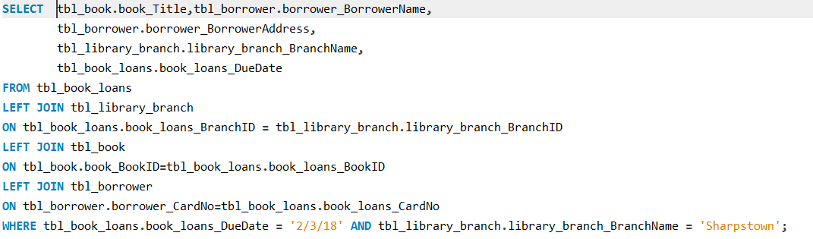
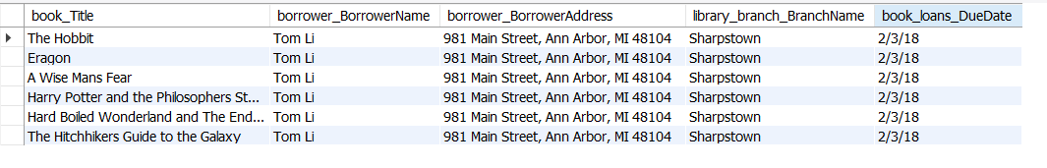
For each book that is loaned out from the "Sharpstown" branch and whose Due Date is 2/3/18, retrieve the book title, the borrower's name, and the borrower's address.
Code:
Result
Title of the book, Borrower name and address who loaned out from “Sharpstown” on 2/3/18 are retrieved by the above query.

Slide 9
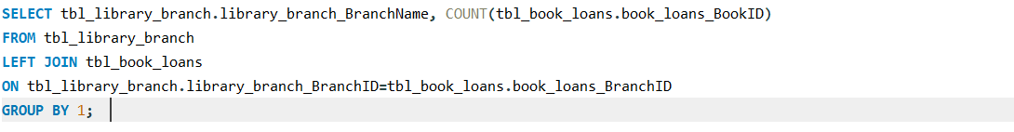
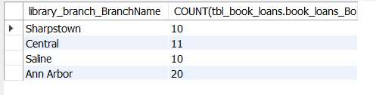
For each library branch, retrieve the branch name and the total number of books loaned out from that branch.
Code:
Result
A total number of 51 book from all branches are loaned out.

Slide 10
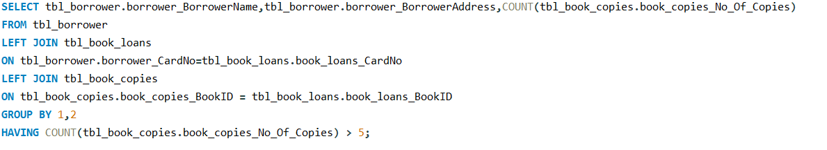
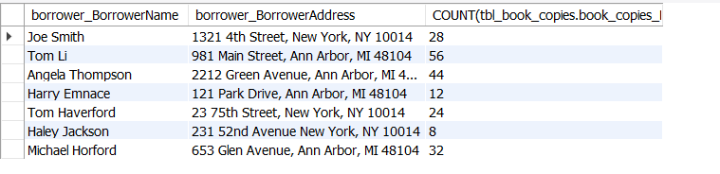
Retrieve the names, addresses, and number of books checked out for all borrowers who have more than five books checked out.
Code:
Result:
These are the following borrowers who checked out more than five books.

Slide 11
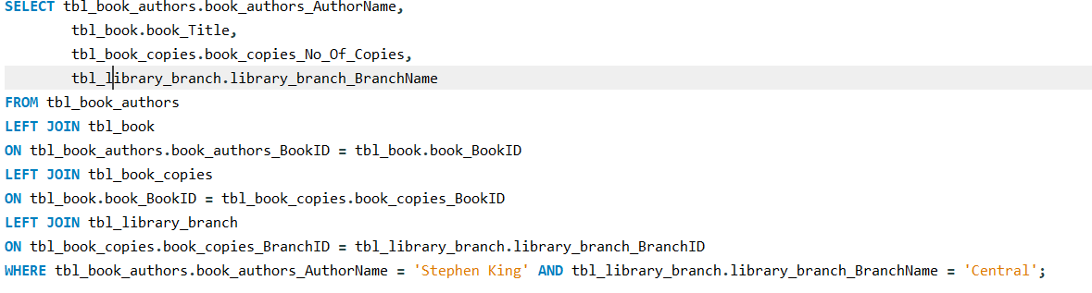

For each book authored by "Stephen King", retrieve the title and the number of copies owned by the library branch whose name is "Central“
Code:
Result:
There are two books which was authored by “Stephenh King” and there are 5 copies which are owned by central library branch.

Slide 12
Business Insights
Uneven Book Distribution Across Branches.
Branch Performance Variance.
Inactive Borrowers Identified.
Overloaded Borrowers Detected.
Rebalance Inventory Across Branches.
Set Borrowing Limits or Alerts.
Optimize Low-Performing Branches.
Regular Data Audits.

Slide 13
Conclusion
This project successfully leveraged data analysis to uncover critical insights within the Library Management System, focusing on book availability, borrower behavior, and branch-level performance.
By identifying key relationships between database tables and extracting actionable metrics, the analysis enabled a deeper understanding of library operations.
The findings support informed decision-making to optimize book distribution, enhance user engagement, and improve overall branch efficiency.
This data-driven approach lays a strong foundation for continuous monitoring and strategic improvements across the library network.

Slide 14
Q & A
What are the struggles that you have faced during this Database management?
How can we implement this analysis for the real time?
How can these insights be integrated into ongoing library operations?
Challenges working on SQL
While Importing the data we need to check the each column data type and any particular anomalies.
If any anomalies are there how can we resolve them.
Joins that we use are should be very particular, and choose wisely by analytical thinking.

Slide 15

THANK YOU

